Slide 1
BLISS- Blended Learning Implementation for reSilient, acceSsible and efficient higher education
UNILJ – Unit 2 Mechatronic Actuators
Disclaimer: Funded by the European Union. Views and opinions expressed are however those of the author(s) only and do not necessarily reflect those of the European Union or the European Education and Culture Executive Agency (EACEA). Neither the European Union nor EACEA can be held responsible for them.

Slide 2
Agenda
Unit Overview
Constructive Alignment:
ILOs
Schedule & Activity Flow for TAs and ATs
Course Content

Slide 3
Unit Overview
Mother Course: Mechatronic Actuators (4 ECTS)
Mother Programme: Bachelor in Mechanical Engineering (Year 1)

Slide 4
Unit Overview
Study-unit Aims: Pneumatics, hydraulics and electrical engineering are topics typically taught within different lectures and by different lecturers. It is therefore often not so easy for students to use this knowledge in an intertwined manner within the same problem/task. Therefore it is important to use all three disciplenes in the same project to fully grasp advantages and drawbacks of each of them.

Slide 5
Unit Overview
Course Topic: Mechatronic Actuators
Blended Learning: Inclass lectures + Work in a group project (obligatory)

Slide 6
Constructive Alignment: ILOs
ILO1 - Compare pneumatic, hydraulic and electric actuator and select an appropriate one for a specific application with regard to cost, environmental conditions, operating conditions.

Slide 7
Constructive Alignment: TAs + ATs
Week 1
Week 2
Week 3
Part 1
Part 2
Part 3
In class Lectures are provided to learn the role of actuators in a general feedback system
TA 1.1
AT 1.1
In Class Lectures are provided to learn pneumatic, hydraulic and electric actuator types and principle of operation
TA 1.2
AT 1.2
In Class Realization
of DC drive as an actuator in a control system
TA 1.3
AT 1.3

Slide 8
Part 1
Week 1
Week 2
Week 3
Part 1
Part 2
Part 3
ILO reference (Highlight the Verb) | Teaching Activity (What the teachers do) | Learning Activity (What the students do)
ILO 1 Compare pneumatic, hydraulic and electric actuator and select an appropriate one for a specific application with regard to cost, environmental conditions, operating conditions. | TA 1.1 The teacher explains (lecture) the basics of control systems and the role of the actuator | LA 1.1 The students are divided in groups. Each group presents an example of an actuator in a real life control system.

Slide 9
Part 1
Week 1
Week 2
Week 3
Part 1
Part 2
Part 3
Supporting Materials:
A ppt of the lectures is provided for reference and future revision.
Supporting equipment: None
Supporting facilities: Lecture room
Instructions:
Just attend the lecture.
Objective: Ensure students understand the role of actuator in a feedback system

Slide 10
Part 1 - Materials

Slide 11
Part 2
Week 1
Week 2
Week 3
Part 1
Part 2
Part 3
ILO reference (Highlight the Verb) | Teaching Activity (What the teachers do) | Learning Activity (What the students do)
ILO 1 Compare pneumatic, hydraulic and electric actuator and select an appropriate one for a specific application with regard to cost, environmental conditions, operating conditions. | TA 1.2 The teacher explains (lecture) the basics of pneumatic, hydraulic actuators. | LA 1.2 The students are divided in groups. Each group presents a more detailed analysis on advantages and drawbacks of three types of hydraulic/pneumatic actuators for their specific project.

Slide 12
Part 2
Week 1
Week 2
Week 3
Part 1
Part 2
Part 3
Supporting Materials:
A ppt of the lectures is provided for reference and future revision.
A video explaining the mathematical modelling of a hydraulic actuator
Supporting equipment: None
Supporting facilities: Lecture room
Instructions:
Students attend the lecture and see the accompanying video at home.
Objective: Ensure students understand the principle of operation of hydraulic, pneumatic and electric actuators

Slide 13
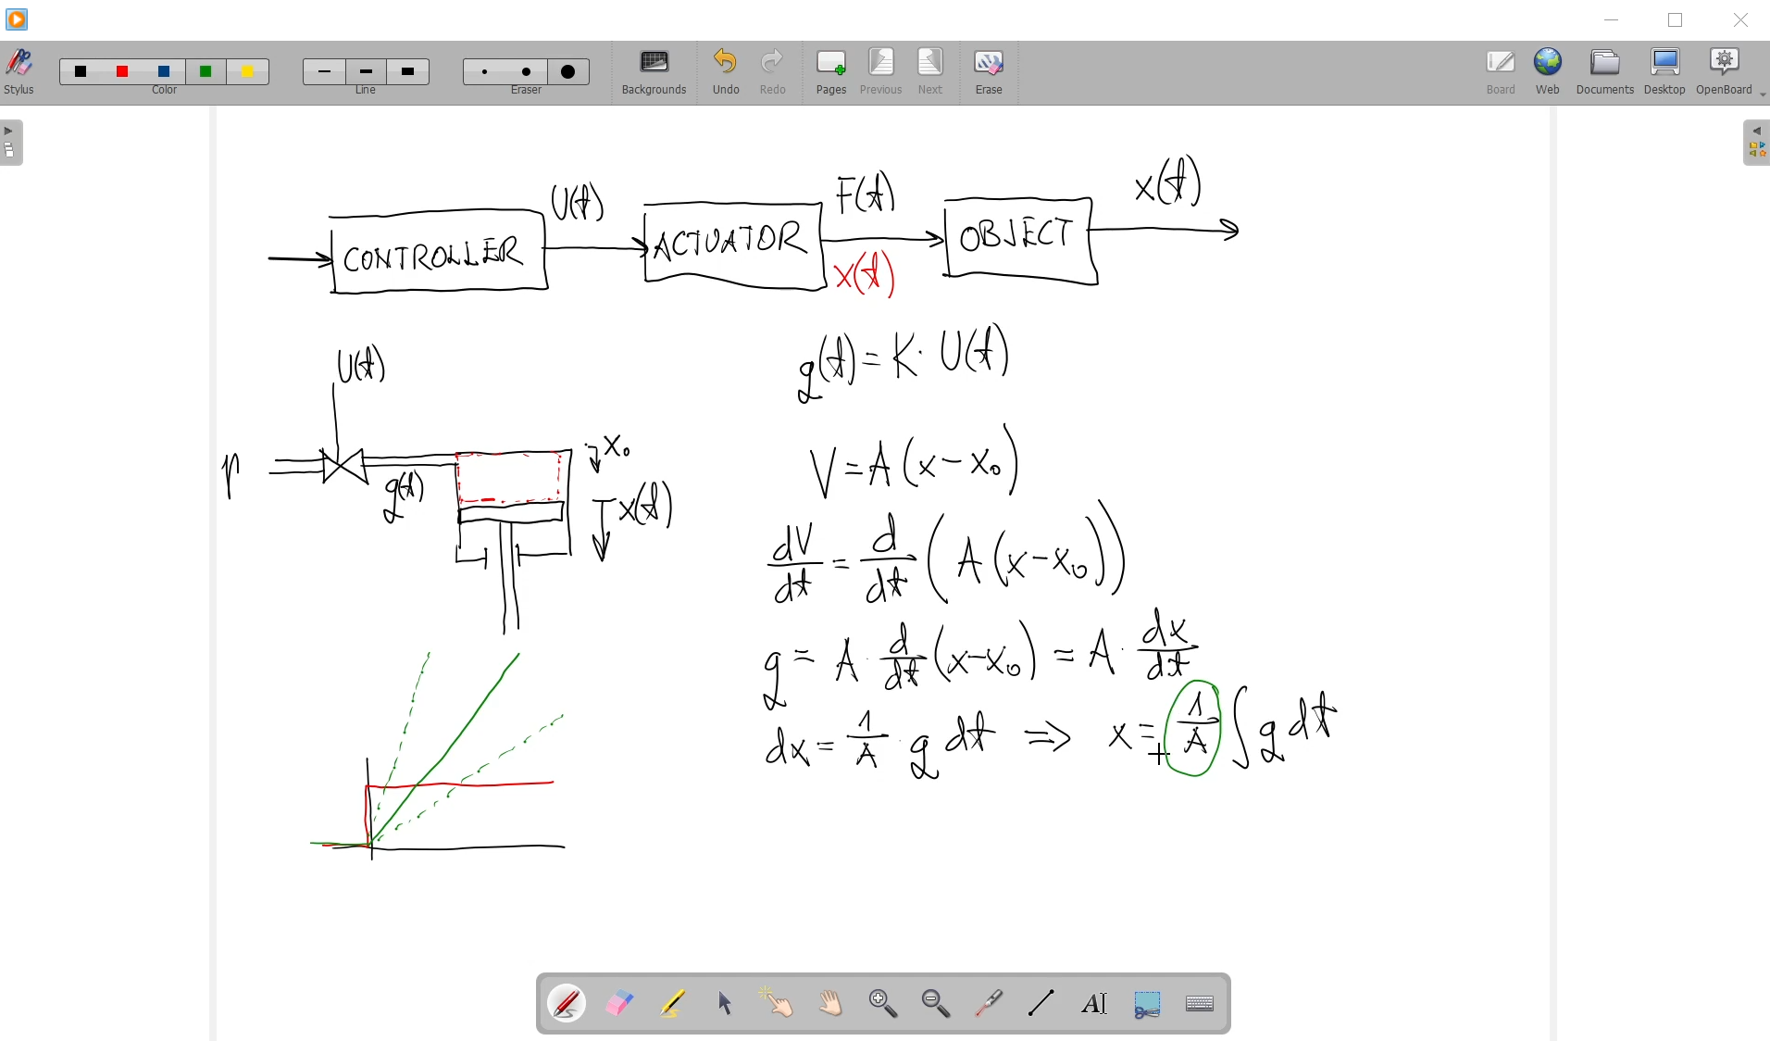
Part 2 - Materials

Slide 14
Part 3
Week 1
Week 2
Week 3
Part 1
Part 2
Part 3
ILO reference (Highlight the Verb) | Teaching Activity (What the teachers do) | Learning Activity (What the students do)
ILO 1 Compare pneumatic, hydraulic and electric actuator and select an appropriate one for a specific application with regard to cost, environmental conditions, operating conditions. | TA 1.3 The teacher explains (lecture) the basics of electric actuators. | LA 1.3 The students are divided in groups. Each group presents a more detailed analysis on advantages and drawbacks of three types of electric actuators for their specific project

Slide 15
Part 3
Week 1
Week 2
Week 3
Part 1
Part 2
Part 3
Supporting Materials:
A ppt of the lectures is provided for reference and future revision.
A video explaining the basics physics underlying electric actuators
Supporting equipment: None
Supporting facilities: Lecture room
Instructions: Students attend the lecture and see the accompanying video at home, students are divided in groups. Each group presents a more detailed analysis on advantages and drawbacks of three types of actuators for their specific project.
Objective: Ensure students understand the principle of operation of hydraulic, pneumatic and electric actuators

Slide 16
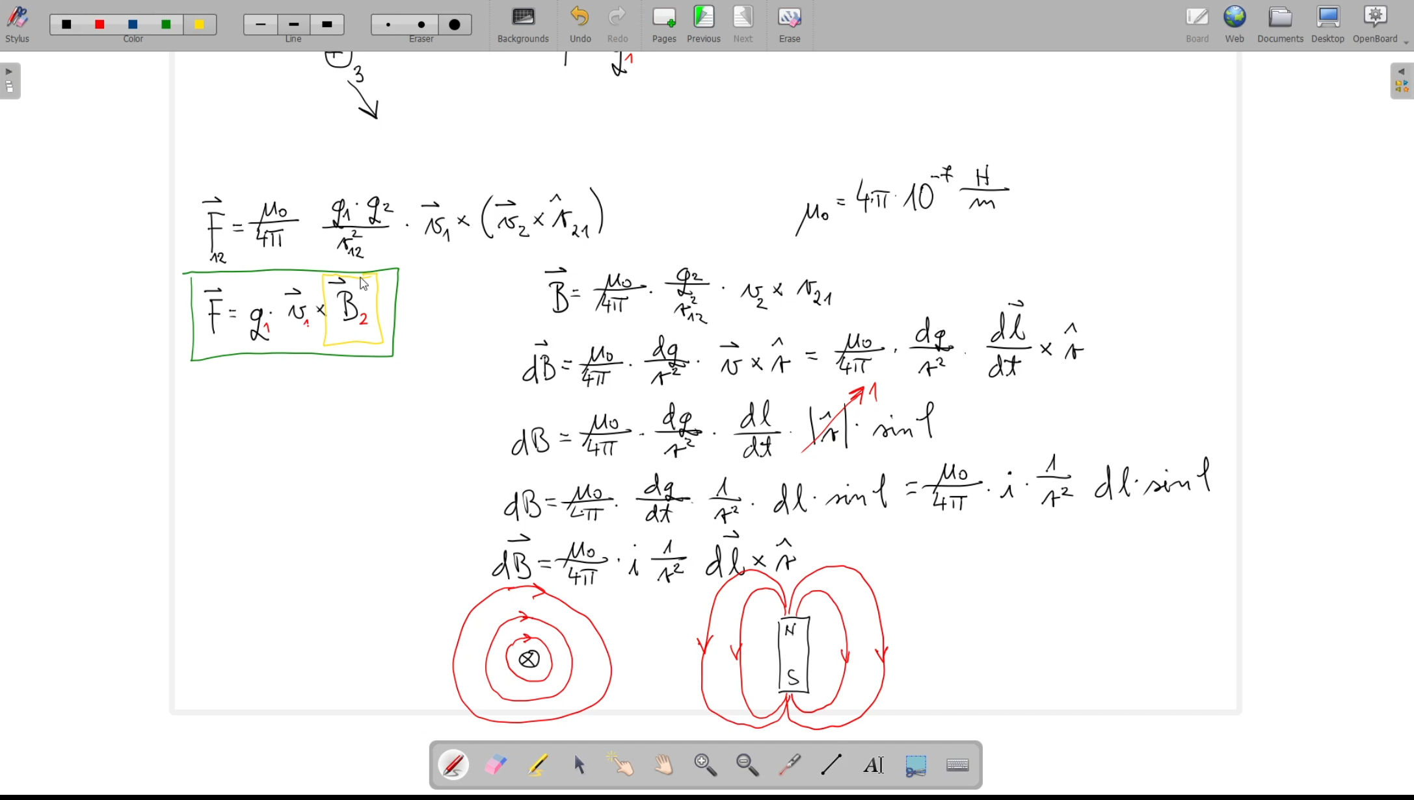
Part 3 - Materials

